Slide 1
Help youth respond to Concerning Posts On Social Media
Notes:
Welcome to today’s training on Helping Youth Respond to Concerning Posts On Social Media.
Introductions ☺

Slide 2
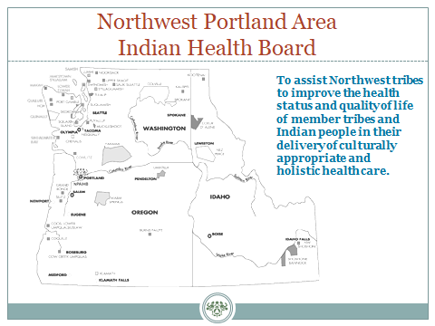
Help youth respond to Concerning Posts On Social Media
Notes:
To give you a little background about the Northwest Portland Area Indian Health Board… It’s a non-profit organization that serves the 43 federally recognized tribes of Oregon, Washington, and Idaho. We R Native is housed in the NW Tribal Epidemiology Center that provides research, surveillance, a capacity-building assistance on behalf of our member tribes.

Slide 3
Agenda
Youth Trends
Concerning Posts
Watch the Video
Review the Viewer Care Plan
Community Awareness Activity
Healthy Native Youth

Slide 4
Youth Trends

Slide 5
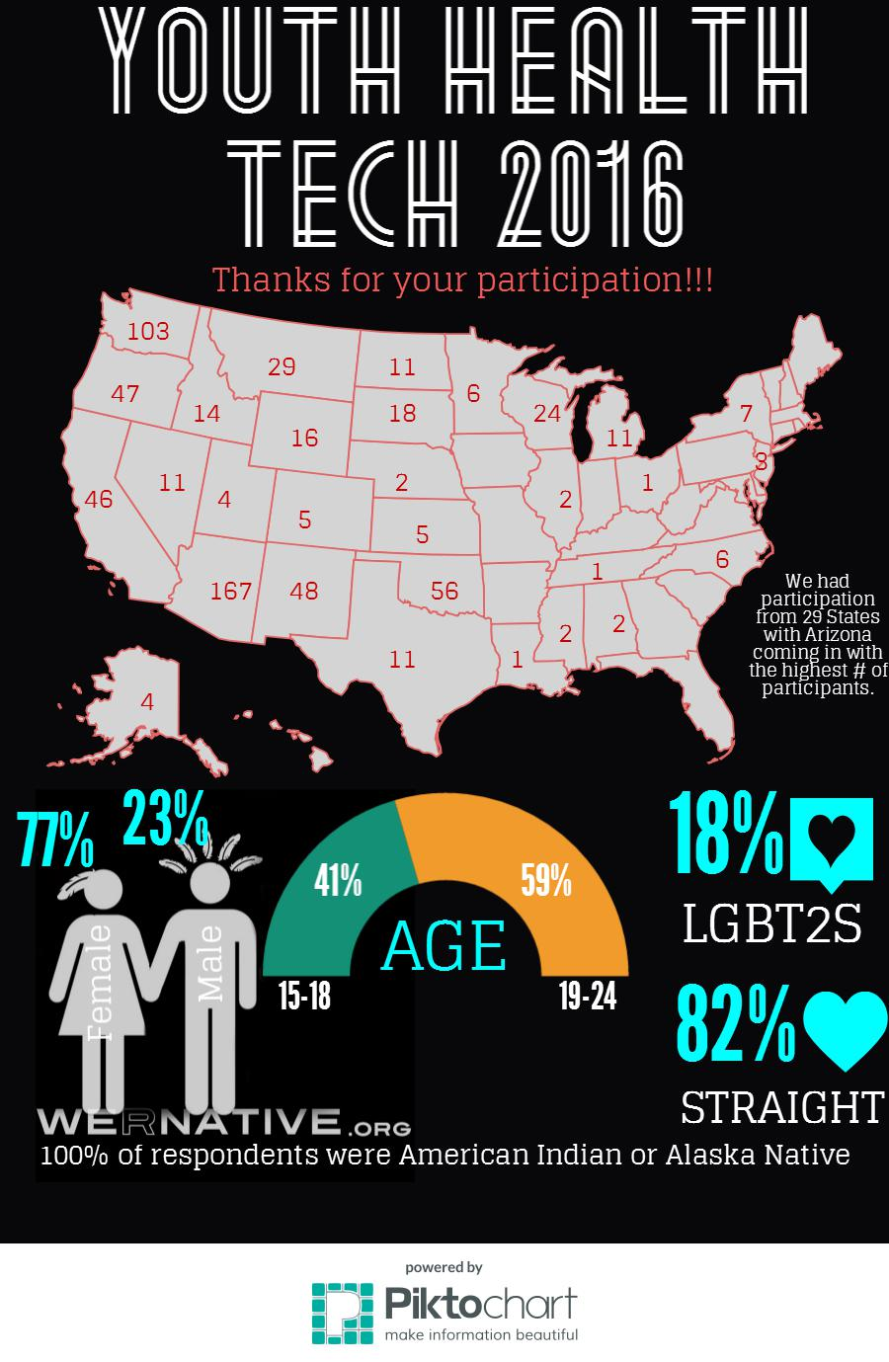
Notes:
Youth Health Tech Survey 2016
n = 679 respondents from 29 States
Participants were recruited from the THRIVE Youth Conference, UNITY’s Annual Conference 2016, and Chemawa Indian School

Slide 7
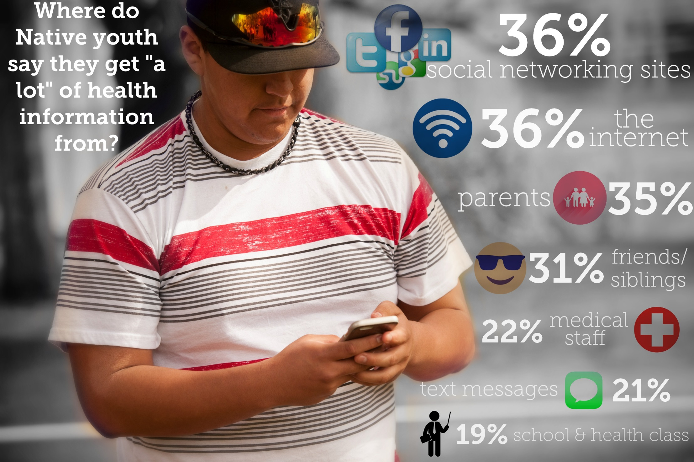
Notes:
Weekly health access to health information:
Social networking sites (such as Facebook, Twitter, or Instagram) = 36%
Internet = 36%
Parents = 35%
Friends or siblings = 31%
Doctors, nurses, clinical staff = 22%
Text Messages = 21%
Health classes in school = 19%

Slide 8
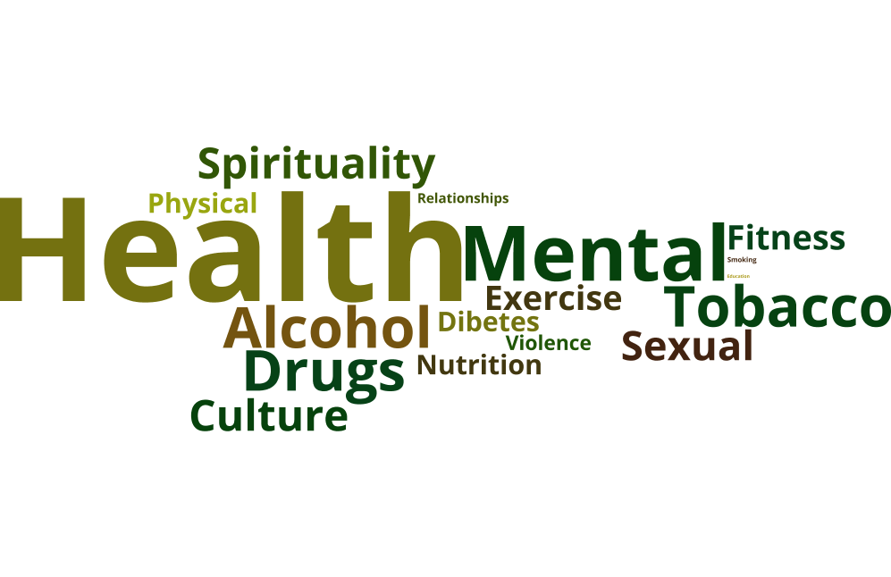
What health topics are important for Native youth to learn about?

Slide 9
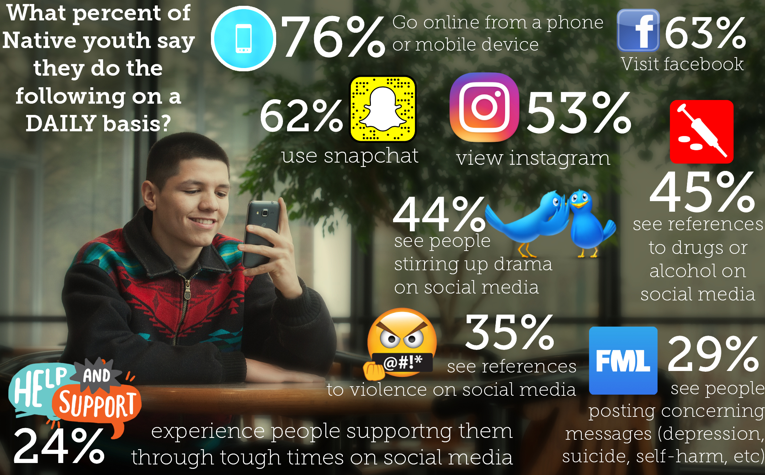
Notes:
Daily activities:
Go online from a phone or mobile device (like a tablet)? = 76%
Visit Facebook? = 63%
Use Snapchat? = 62%
View Instagram? = 53%
Concerning Trends…
See references to drug or alcohol use on social media? = 45%
See people stirring up drama on social media? = 44%
See references to violence on social media? = 35%
See people posting concerning messages on social media (like references to depression, suicide, or self-harm)? = 29%
Experience people supporting you through challenging/tough times on social media? = 24%
Our goal is to meet young people where they are… to deliver health information when and where they’re ready, and to cover the topics that matter most to them.

Slide 10
Concerning Posts

Slide 11
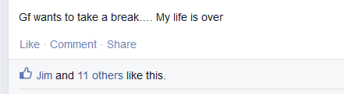
What are “Concerning Posts”?
Concerning posts include those that express depression or intent to hurt one’s self or others, that have been posted on a social media site, such as Facebook, Instagram, Twitter, or Snapchat.
Notes:
Before we proceed with the training, so we’re all on the same page…
When we talk about concerning posts today, we are referring to posts that express depression, grief, intent to hurt one’s self, or intent to hurt others, that have been posted on a social media site, such as Facebook, Instagram, Twitter, or Snapchat.

Slide 12
Why is this training important?
Suicide prevention remains challenging among youth, as many do not disclose suicidal ideation to others before attempting suicide. Emerging research suggests that youth may disclose depression symptoms and suicidal ideation via social media, such as Facebook and Twitter.
These public disclosures may provide new opportunities to identify youth at risk and connect them to appropriate resources and support.
Notes:
As you know, suicide prevention remains challenging among youth, as many do not disclose thoughts of suicide before making an attempt. However, emerging research suggests that youth may disclose depression symptoms and suicidal ideation via social media. These public disclosures may provide new opportunities to identify youth at risk and connect them to appropriate resources and support.

Slide 13



Seattle Children’s Hospital
“Goal is to advance society’s understanding of the relationship between media and adolescent health.”
Notes:
The Social Media and Adolescent Health Research Team (SMAHRT) is based in the Center for Child Health, Behavior and Development at Seattle Children’s Hospital. Their goal is to advance society’s understanding of the relationship between media and adolescent health.

Slide 14
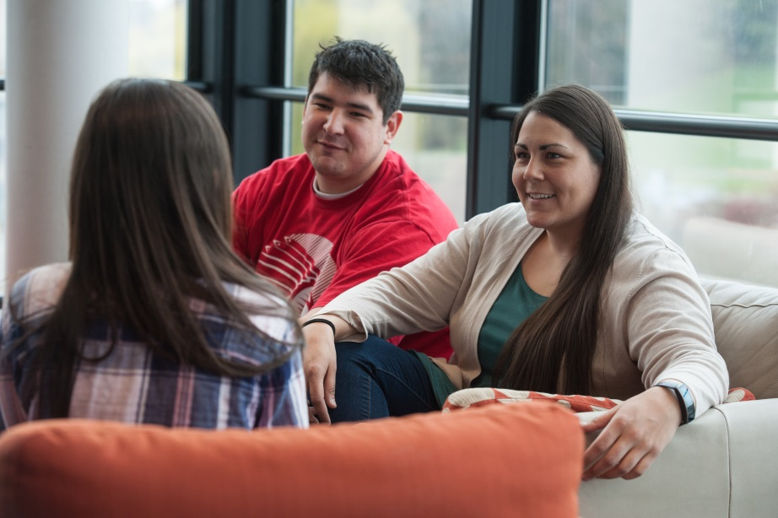
Who is this training for?
As a parent, mentor, teacher, or health educator, YOU are trusted advocates and resources for Native youth.
In some cases,
you might be
the only person
a young adult
feels they can
talk to.
Notes:
We often advise youth to talk to a trusted adult when they need help, but who are these ‘trusted adults’ exactly? It’s you! As a parent, mentor, teacher, or health educator, YOU are trusted advocates for Native youth.
During our conversations with youth, all of them said that they’d seen concerning posts online, but most didn’t know how to respond and wanted support from a trusted adult. When we asked health educators how they felt about this, only 5% felt adequately prepared to respond.
That’s why we created this training for you, regardless of your professional role or experience. In some cases you might be the only person a young adult feels they can talk to.

Slide 15

Goal for the Training
Our goal is to ensure you feel prepared when a youth approaches you about a concerning post on social media.
Notes:
As a trusted adult, our goal is to ensure you feel prepared when a young person approaches you about seeing concerning posts on social media.

Slide 16
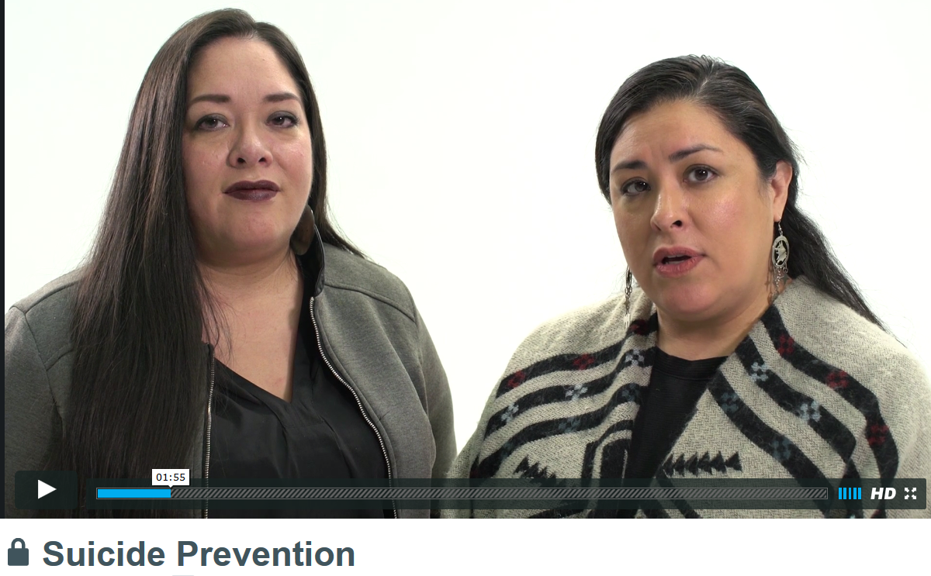
1. Watch the video training (30 min.)
Please click here to watch the training video.
Notes:
Please click on the link to begin watching the 30 minute video.
Once you’re done watching the video, return to this tab on your browser to move on to the next slide.

Slide 17
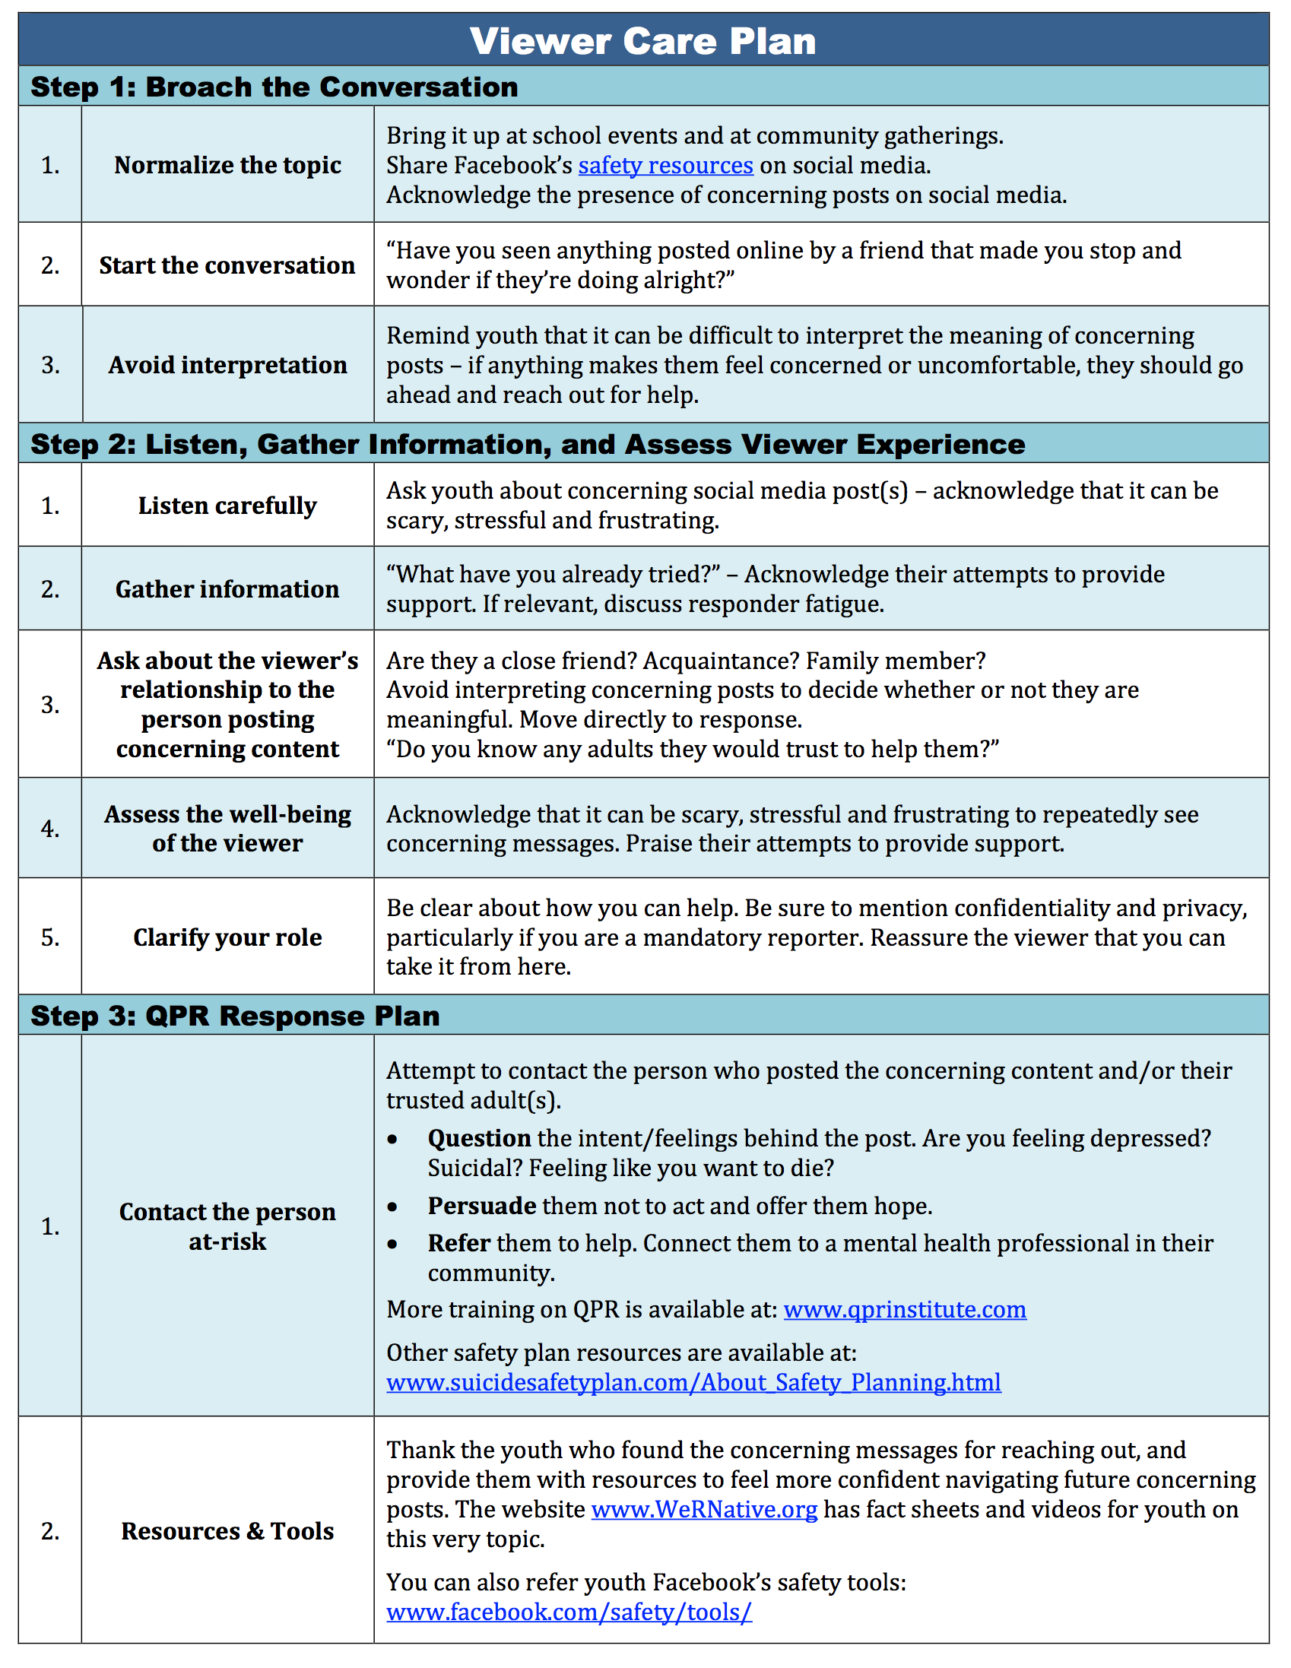
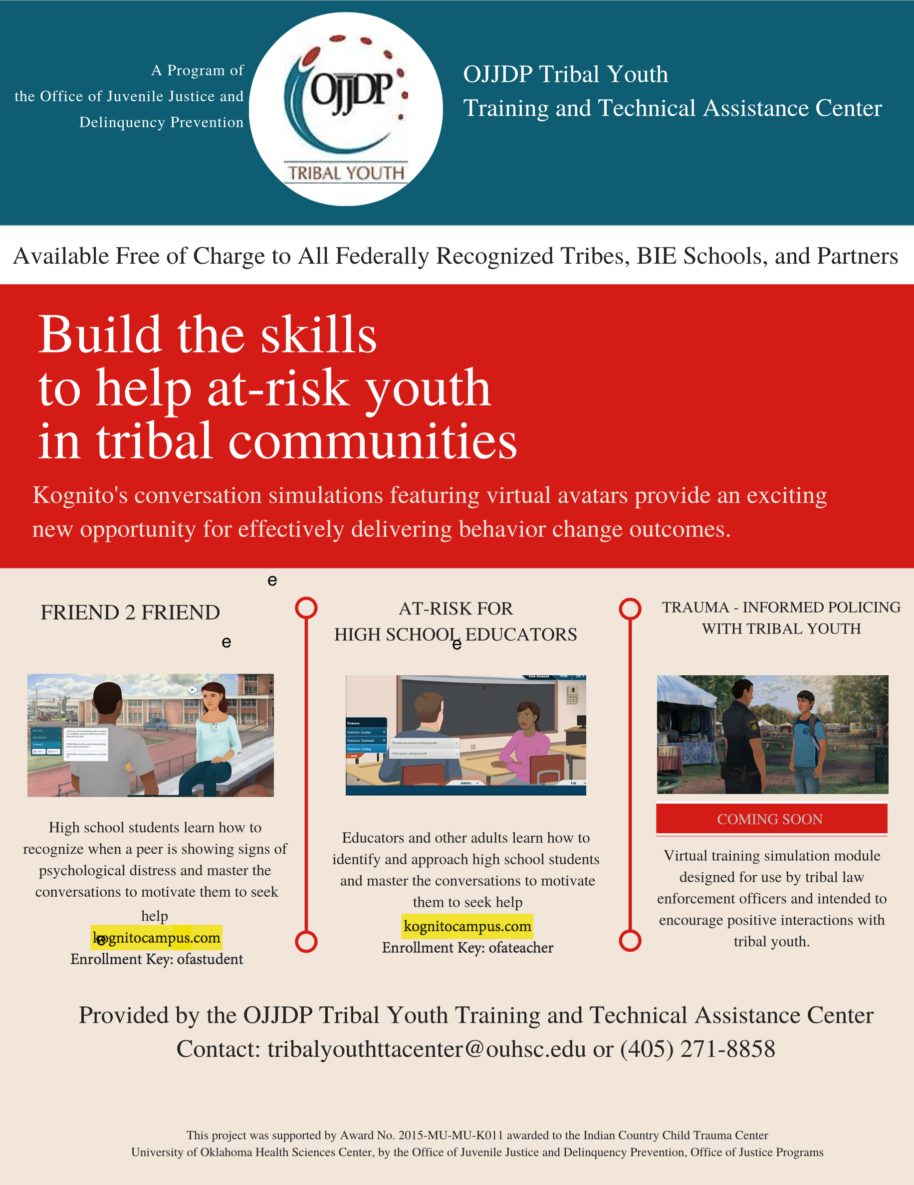
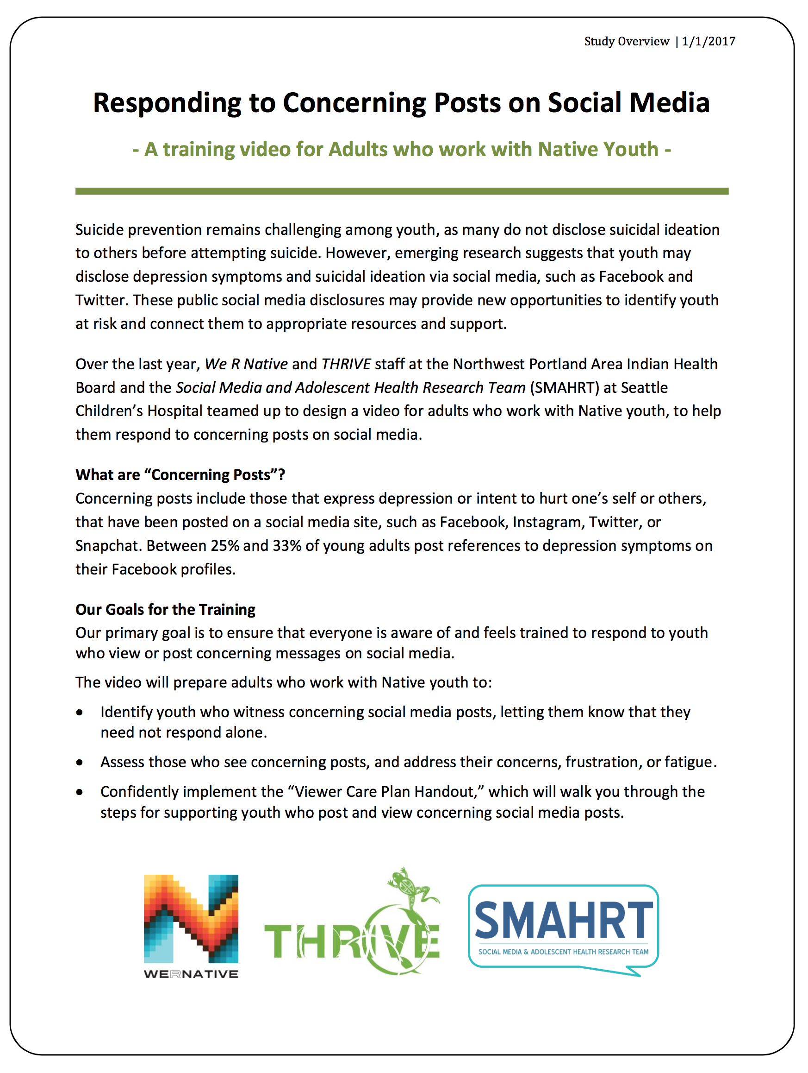
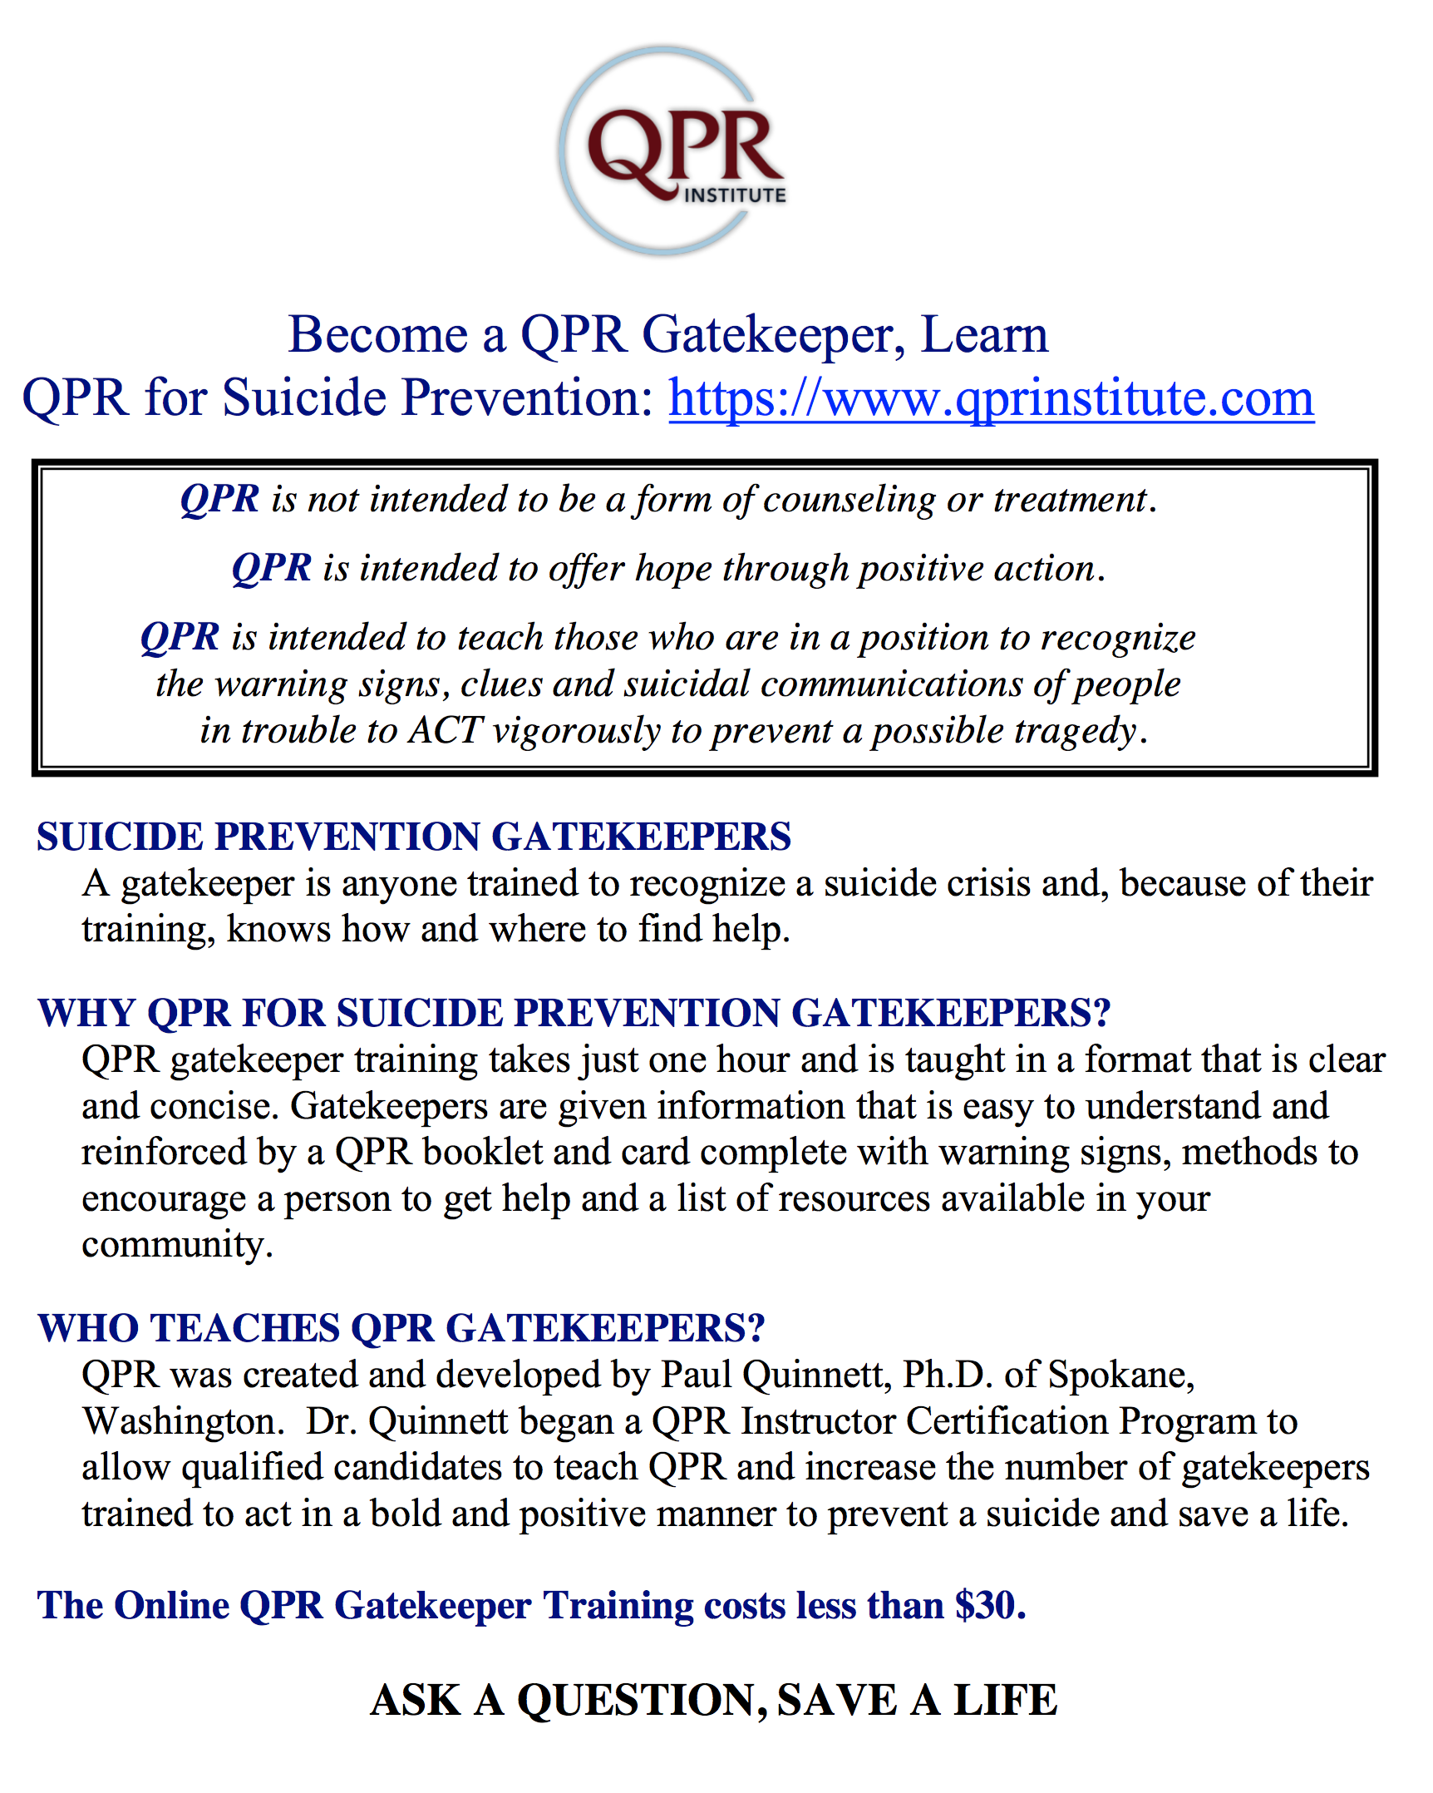
Review Training Handouts
Notes:
We created some handouts to help walk you through each of these steps. The handouts can be found under the “Resources Tab” and can be downloaded and printed from here.

Slide 18
Overview for Participants
Notes:
The first handout looks like this:

Slide 19
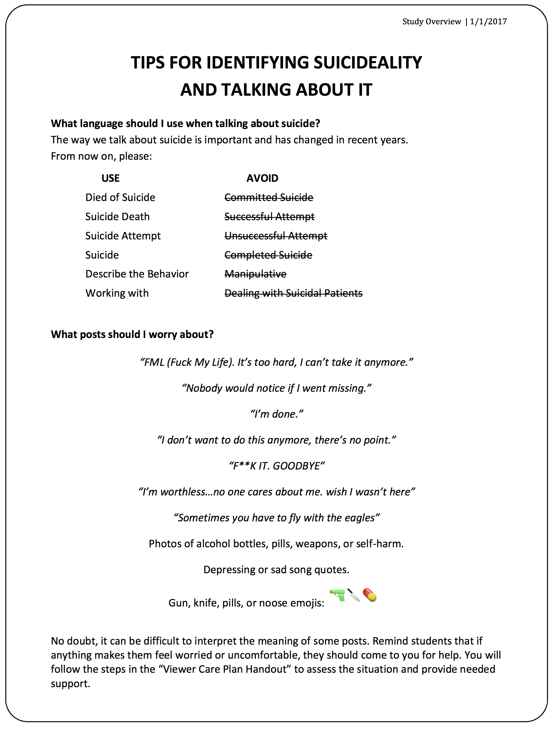
What language should I use?
Notes:
If you turn to page two, you can find tips for identifying suicideality and tips for talking about it.
We want to make sure we use the right terms when we talk about suicide. It’s important to review, as they have changed in recent years.
From now on, please:
USE terms like: Rather than terms like:
Died of Suicide Committed Suicide
Suicide Death Successful Attempt
Suicide Attempt Unsuccessful Attempt
Suicide Complete Suicide
Describe Behavior Manipulative
Working with Dealing with Suicidal Patients

Slide 20
What Posts Should I Worry About?
Notes:
Also on page two, you can see examples of concerning posts that you might encounter on social media:
“FML (Fuck My Life). It’s too hard, I can’t take it anymore.”
“Nobody would notice if I went missing.”
“I’m done.”
“I don’t want to do this anymore, there’s no point.”
“F**K IT. GOODBYE”
“I’m worthless...no one cares about me. wish I wasn’t here”
“Sometimes you have to fly with the eagles”
Photos of alcohol bottles, pills, weapons, or self-harm.
Depressing or sad song quotes.
Gun, knife, pills, or noose emojis.
No doubt, it can be difficult to interpret the meaning of some posts. Remind youth that if anything makes them feel worried or uncomfortable, they should come to you for help.

Slide 21
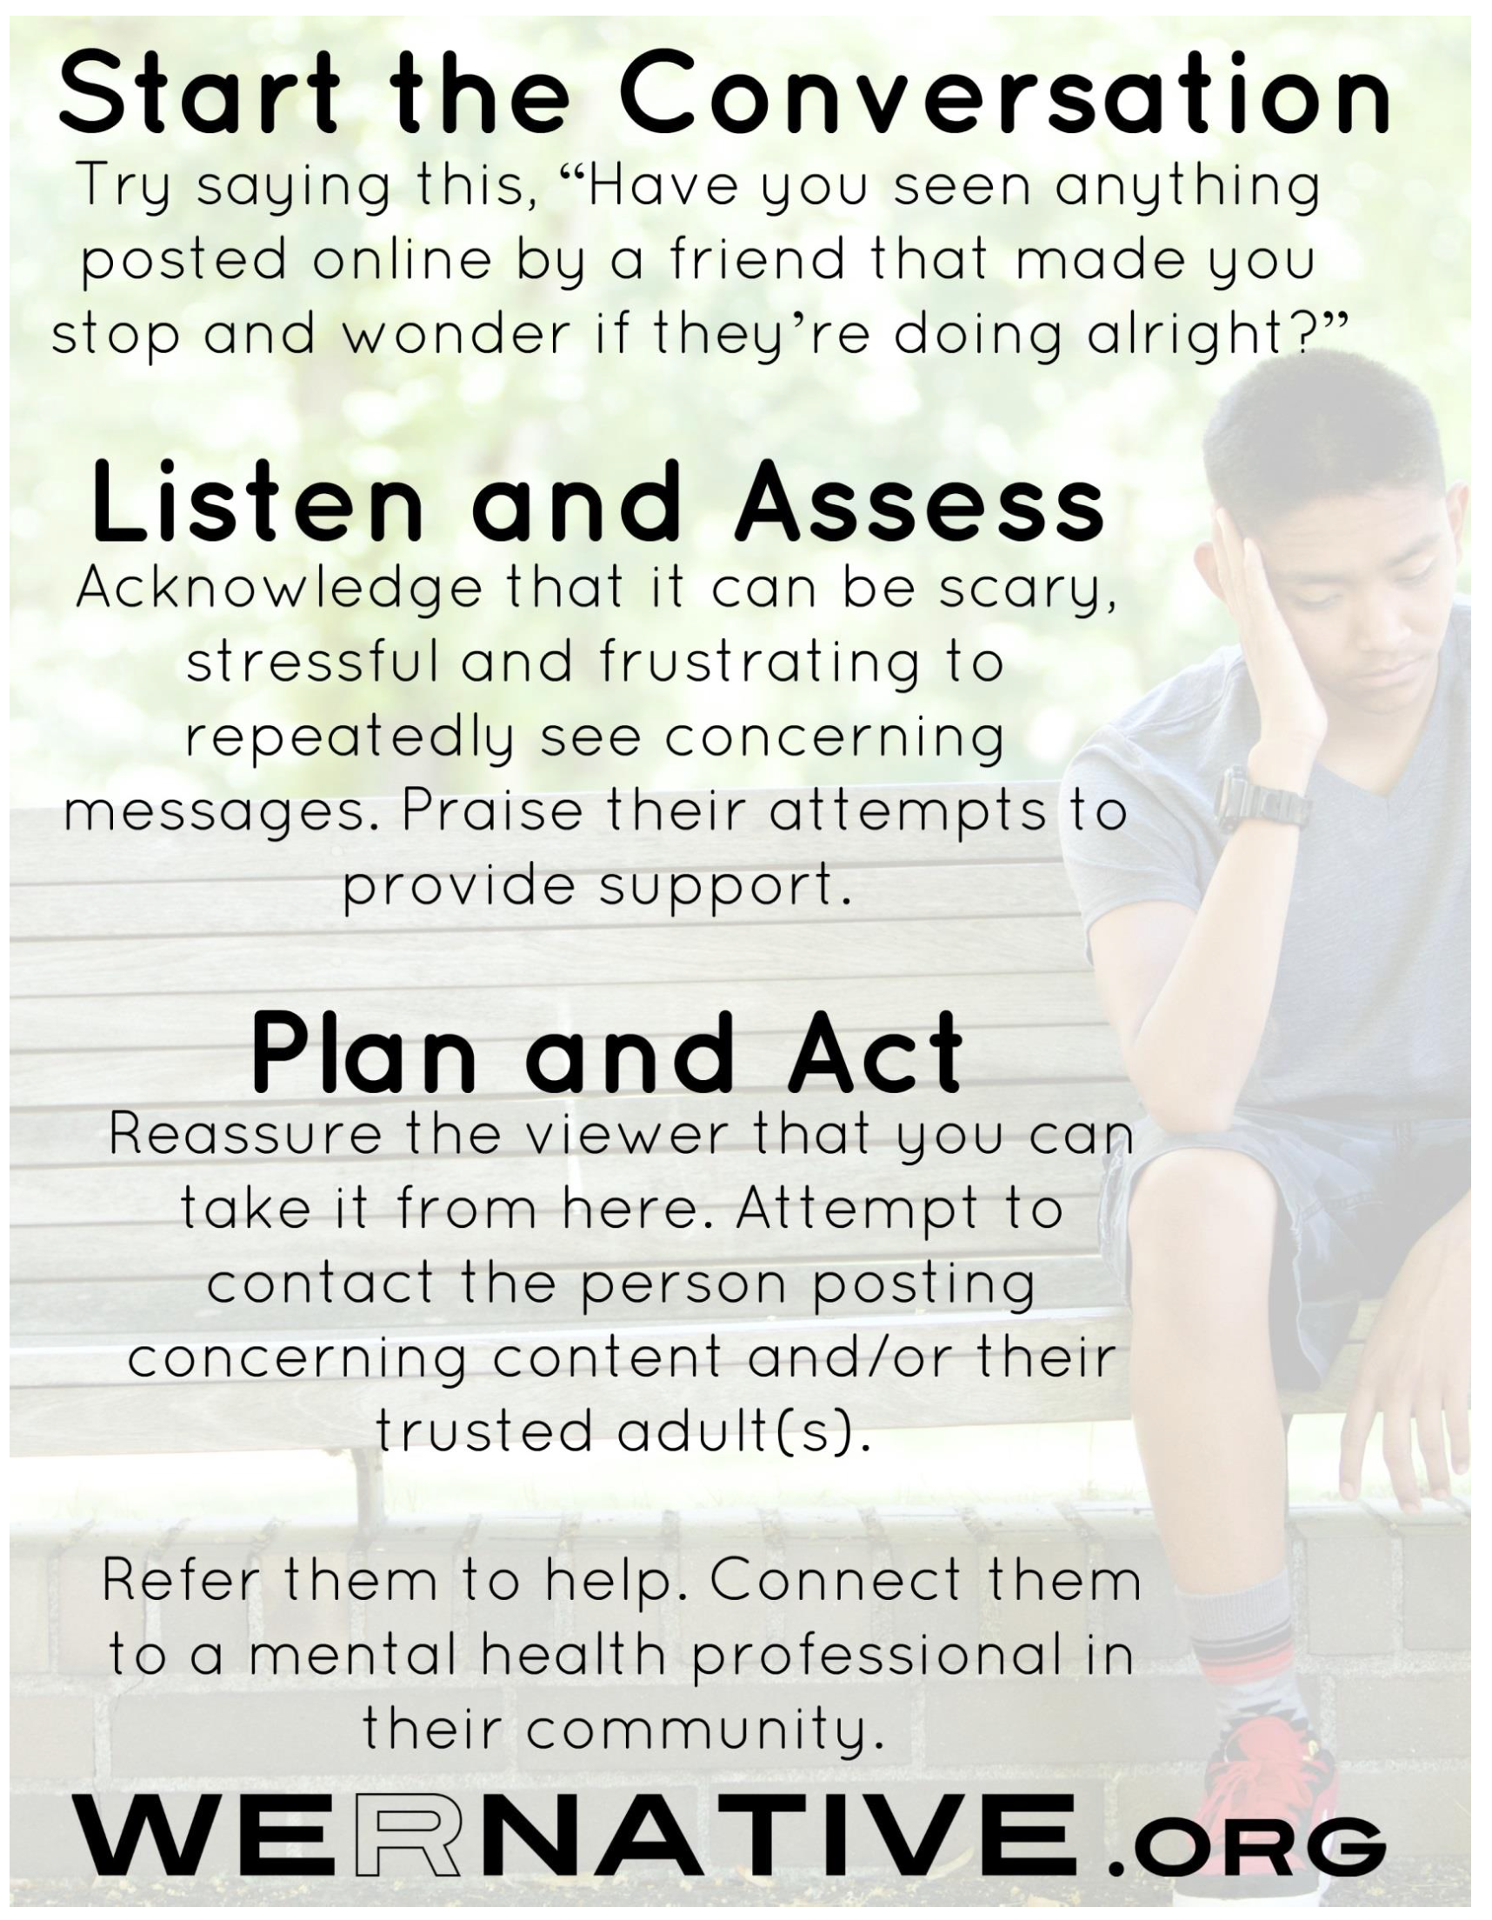
Viewer Care Plan
Notes:
The Viewer Care Plan is a one-page reference sheet that will walk you through each of the three steps, offering tips and suggestions.
You can post the Viewer Care Plan in your home or office. You can also take a picture of the plan with your phone, so that it is accessible to you at all times.

Slide 22
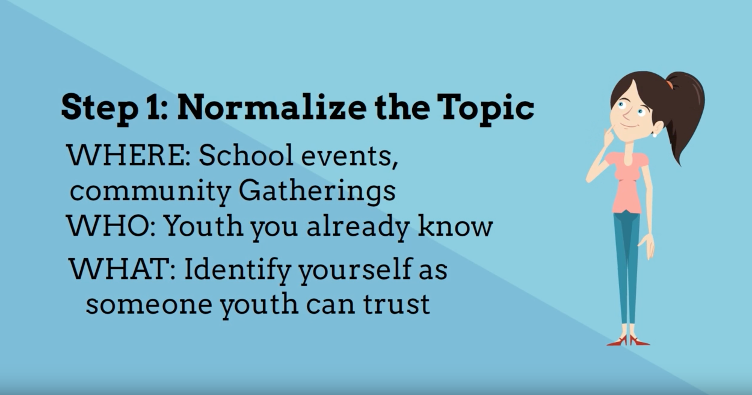
Step 1: Start the Conversation
Notes:
Next, we want to review the Viewer Care Plan, so that you feel comfortable using it if the time comes.
The first step is to normalize the topic by bringing it up at school events and community gatherings.
Start the conversation with youth you already know. Tell them you just got trained, that you are someone they can trust and turn to if needed.
Remind them that it can be difficult to know the meaning of concerning posts. If anything makes them feel concerned or uncomfortable, they should reach out for help by letting you know what’s gong on.

Slide 23
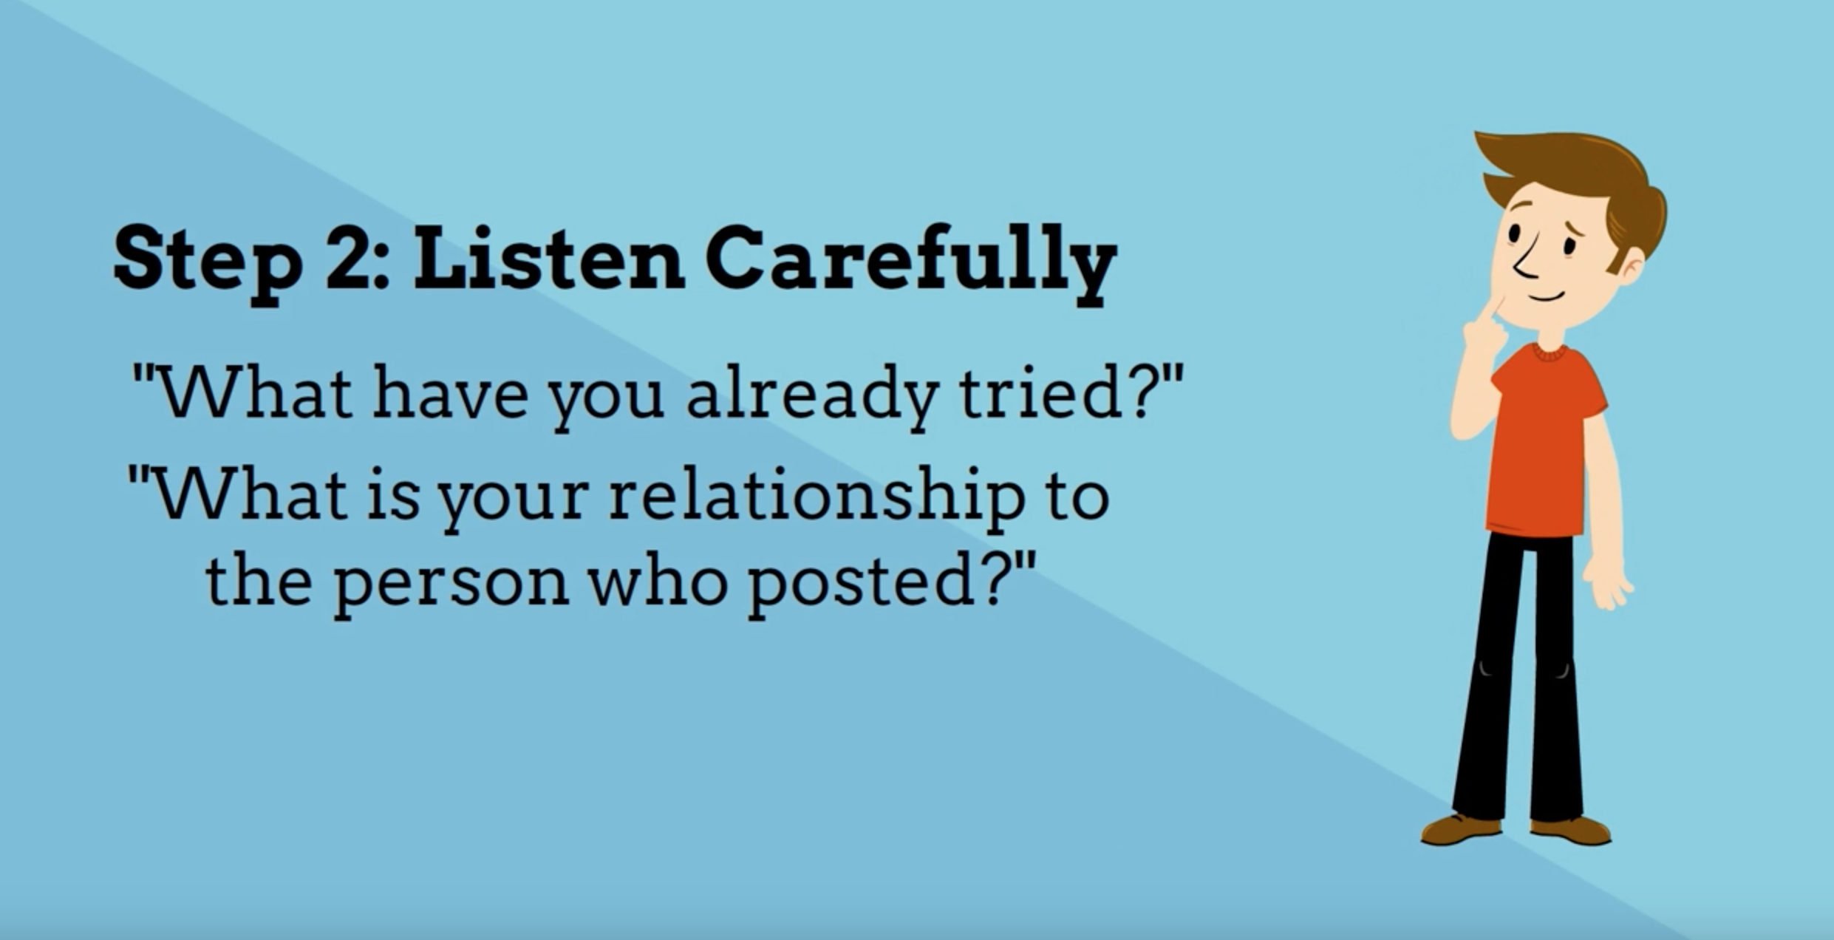
Step 2: Listen & Assess
Notes:
If a youth comes to you for help, listen carefully and gather more information.
Ask them:
“Have you said or done anything in response to the post yet?”
“Have you seen them post anything like this before?”
Ask them their relationship to the person who posted the message:
“Was it a close friend? An acquaintance? A family member?”
Ask them if they know any of their trusted adults.
Acknowledge that it can be stressful to repeatedly see concerning messages. Ask:
“How are you feeling after seeing this? I know it can be scary”
“If you are still feeling concerned after today, come back and talk to me. I can connect you to someone to talk to.”
Praise their attempts to provide support and ensure their privacy:
“You did the right thing.”
“If you’d like, I won’t say it was you who told me.”

Slide 24

Step 3: Plan & Act
Notes:
Reassure the viewer that you will take it from here.
If you feel comfortable contacting the person who posted the concerning message, you can use the QPR model:
Question the intent/feelings behind the post. Are you feeling depressed? Suicidal? Feeling like you want to die?
Persuade them not to act and offer them hope.
Refer them to help. Connect them to a mental health professional in their community.
If you don’t feel comfortable contacting them directly, reach out to their trusted adult(s). It can be a parent, a coach, an aunt or uncle, a counselor, someone who can help form a response plan.

Slide 25

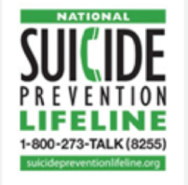

Resources
Notes:
Provide the youth who found the concerning messages with resources to feel more confident navigating future concerning posts:
The website www.WeRNative.org has fact sheets and videos (https://youtu.be/3dHYTPtsVGw https://youtu.be/x7wr8sGTYgI https://youtu.be/QDZlB-skw24) for youth on this very topic.
It would also be a good idea to familiarize yourself with local resources, like mental health professionals or counselors in your community.

Slide 26
Tips for Responding
Respond quickly
Provide them with a LOT of reassurance
  “I’m so glad you noticed this and shared this with me.”
  “You are so brave for speaking up.”
Be CLEAR about what you’re going to do next.
Most importantly, take the responsibility off the youth to respond – you are better equipped to get help than they are.
Notes:
If someone does come to you with a concern:
Try to respond quickly. This is especially true if they reach out to you via text message.
Give them LOTS of reassurance, so they know they did the right thing by reaching out to you:
“I’m so glad you noticed this and shared this with me.”
“Thanks for coming to me. You are so brave for speaking up.”
Be clear about your roles moving forward:
“I’ll follow-up with their coach after practice.”
“I’ll talk to their school counselor first thing tomorrow morning.”
“I’ll call their mom now. You did the right thing. I will take it from here.”
Most importantly, take the responsibility off the youth to respond – you are better equipped to get help than they are.

Slide 27
QPR Gatekeeper Training
If you would like more training on suicide intervention skills, the QPR training is:
Available in-person
Or it’s about $30 to take a 1 hour online training
Notes:
If you would like more training to improve your intervention skills, the QPR Training handout gives you more information. The training is available in-person or online.

Slide 28
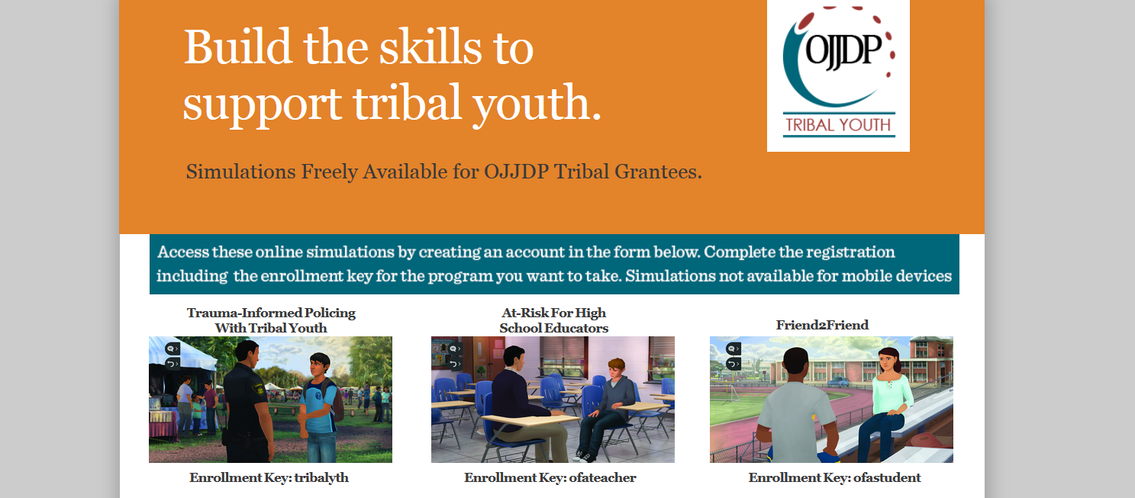
Kognito
They offer a free, online, interactive training for high school students and educators.
Notes:
And Kognito offers a free, online, interactive training for high school students and educators, provided by the Office of Juvenile Justice and Delinquency Prevention.
You can find their contact information on the Kognito handout.

Slide 29
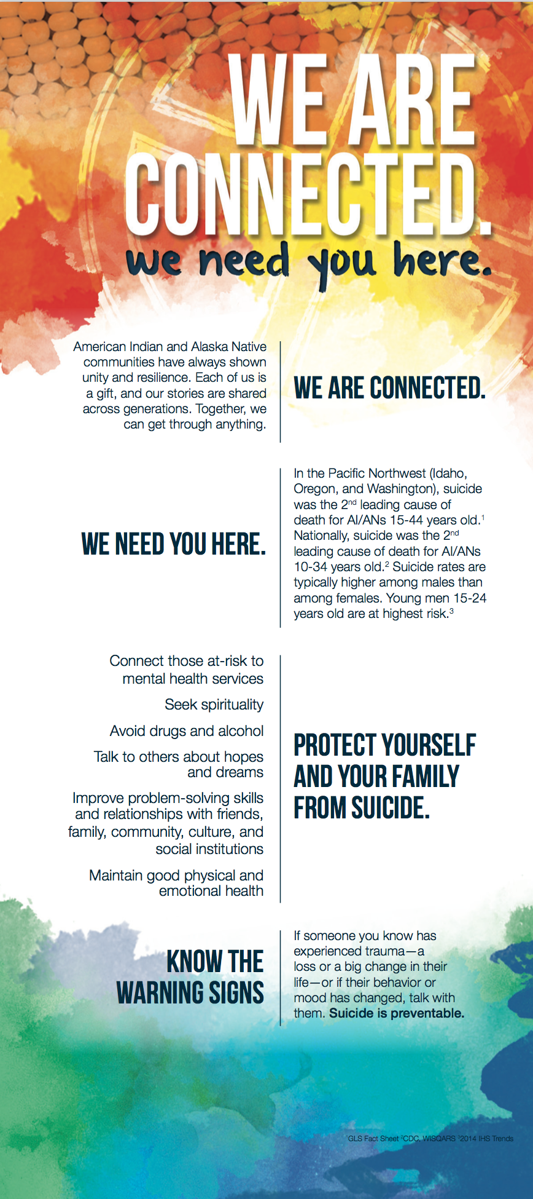
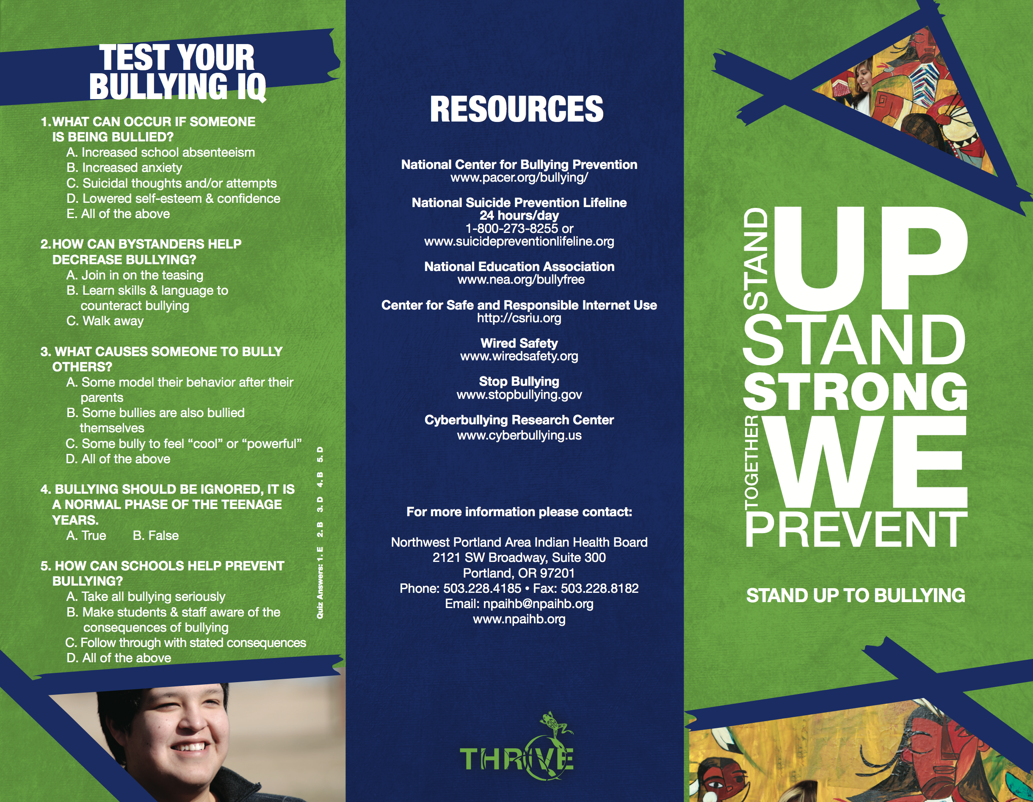
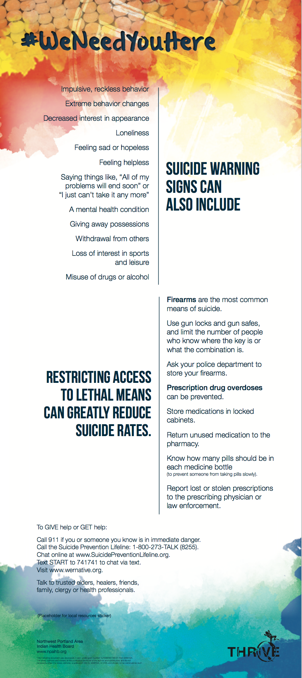
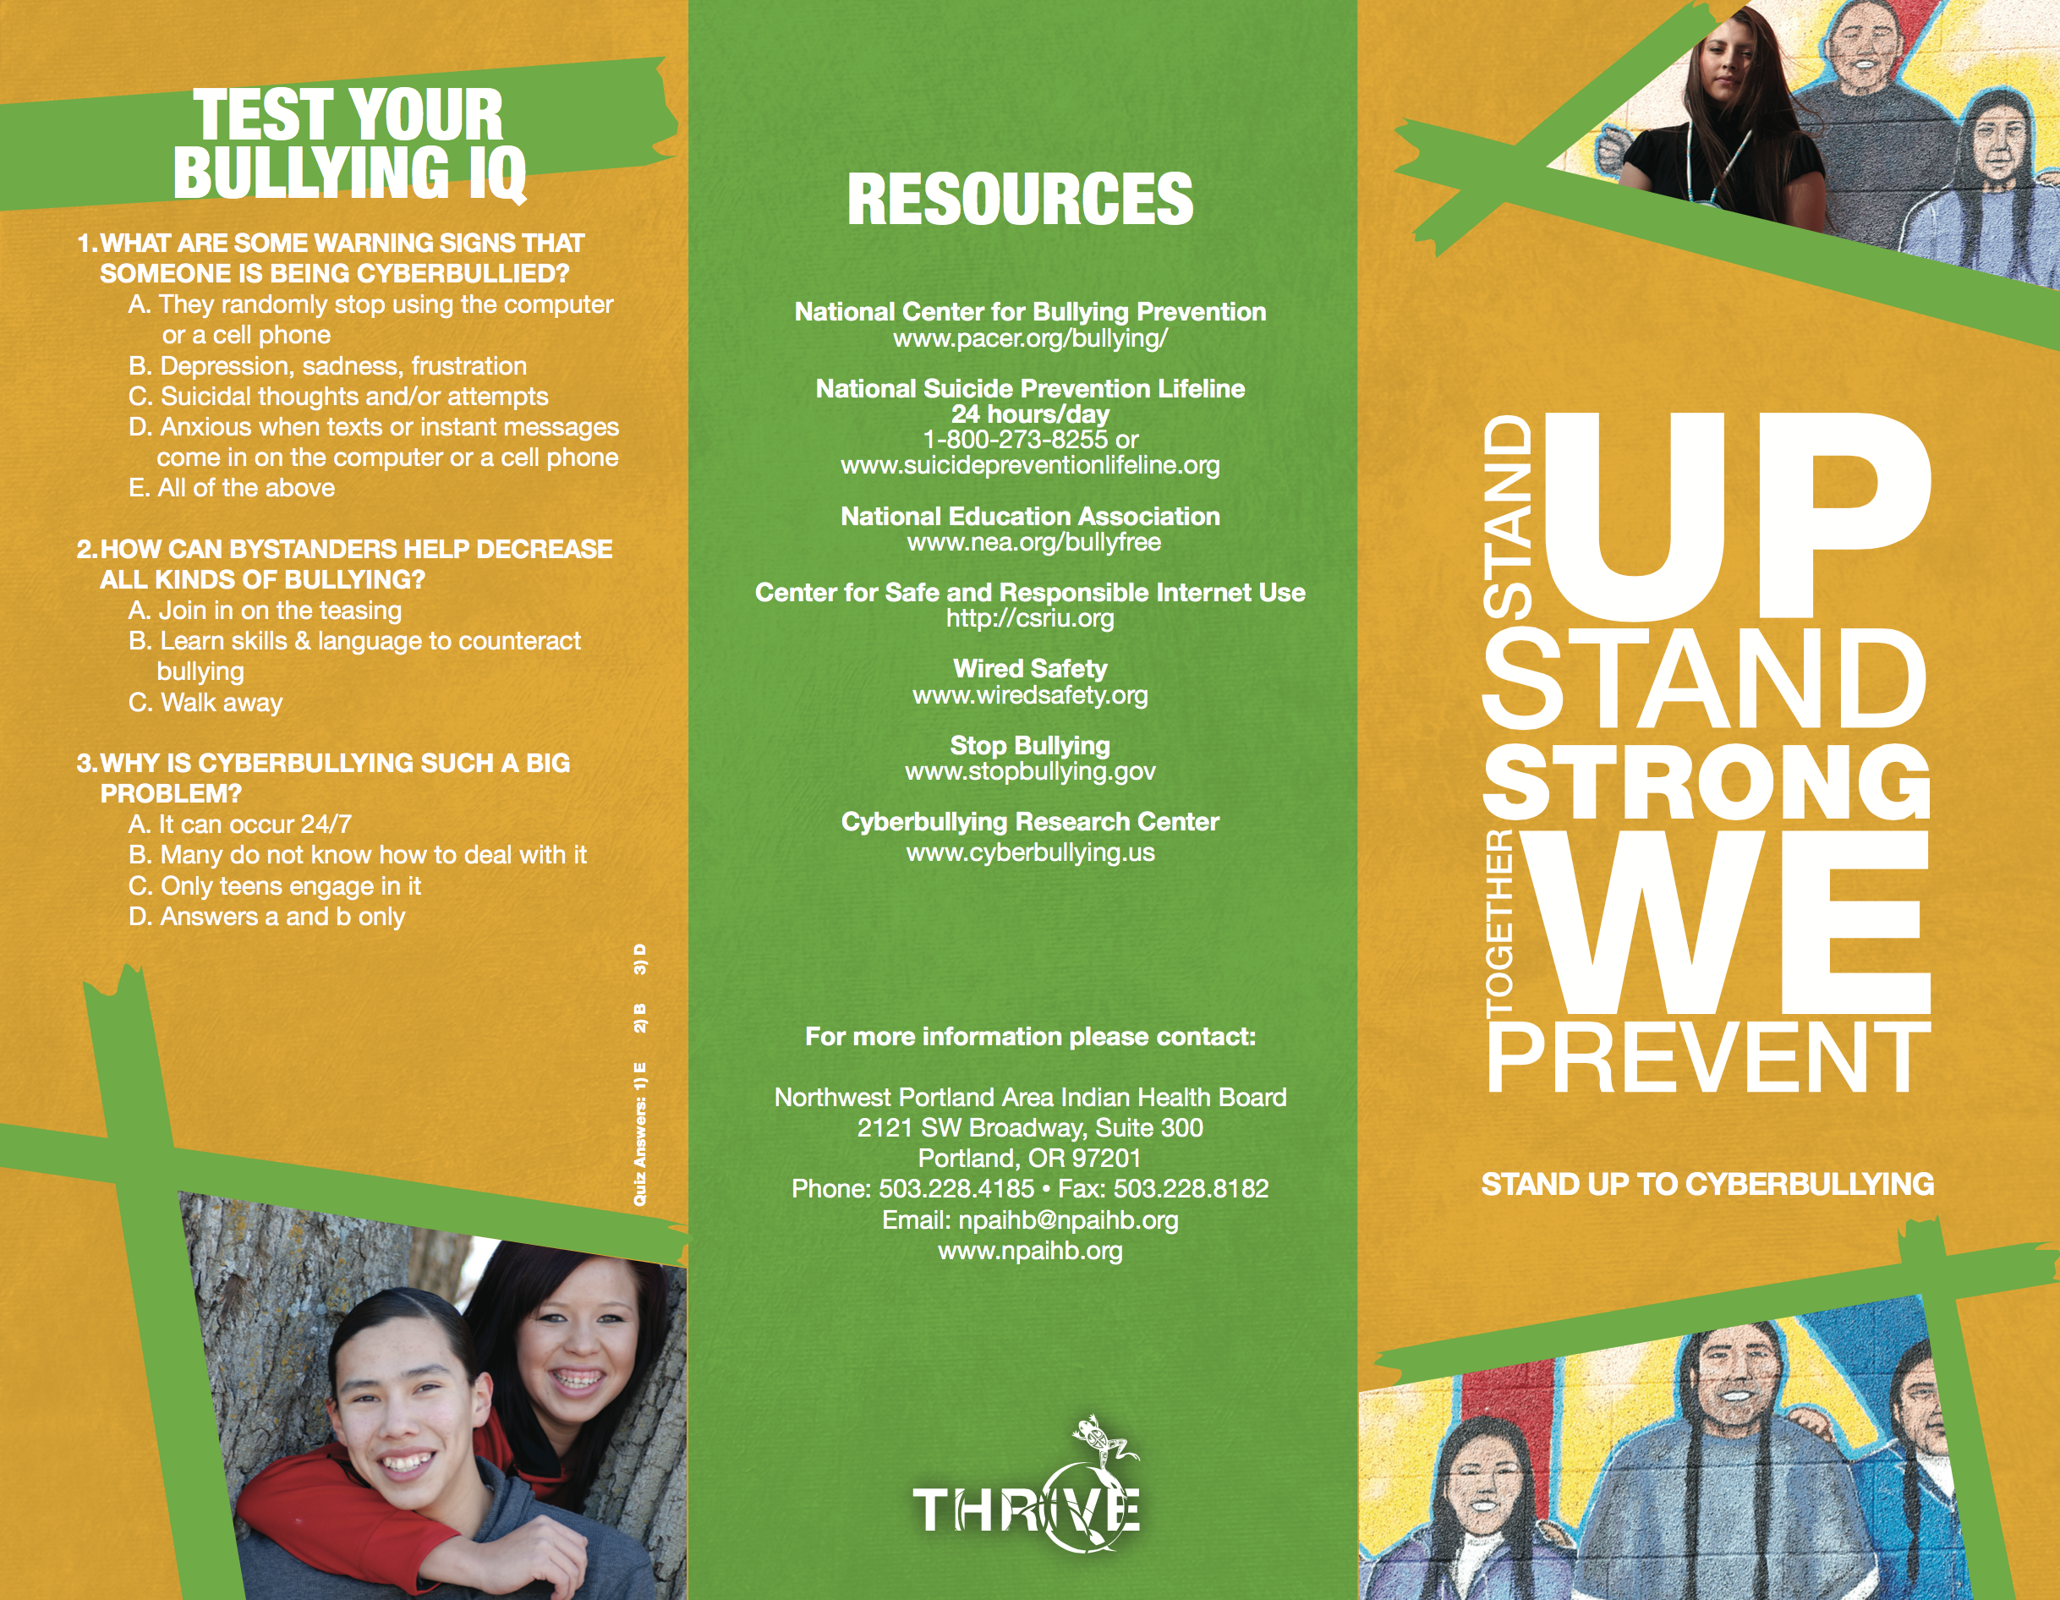
THRIVE Suicide & Bullying Brochures
Notes:
We’ve included some THRIVE suicide and bullying brochures that you can share with youth and folks in your community.

Slide 30
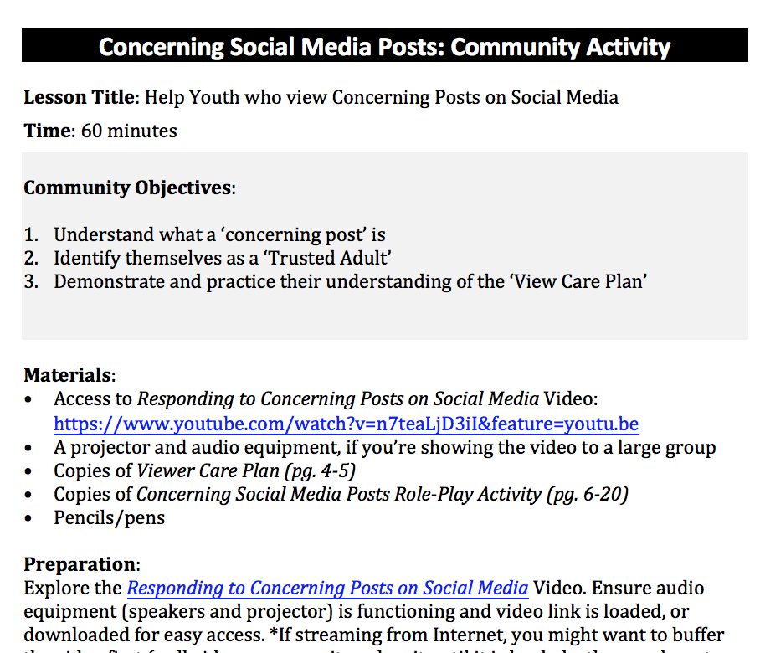
Community Awareness Activity
Notes:
Also attached as a “Resource,” we’ve created a Community Awareness Activity that you can use to raise awareness about this topic with youth and adults in your community. It can be used just about anywhere: at school events, at a staff meeting, a tribal council meeting, or at tribal gatherings.
Depending on the age of your audience and the amount of time you have, you can show the Concerning Post video or just do the role-play activities described in the guide.

Slide 31
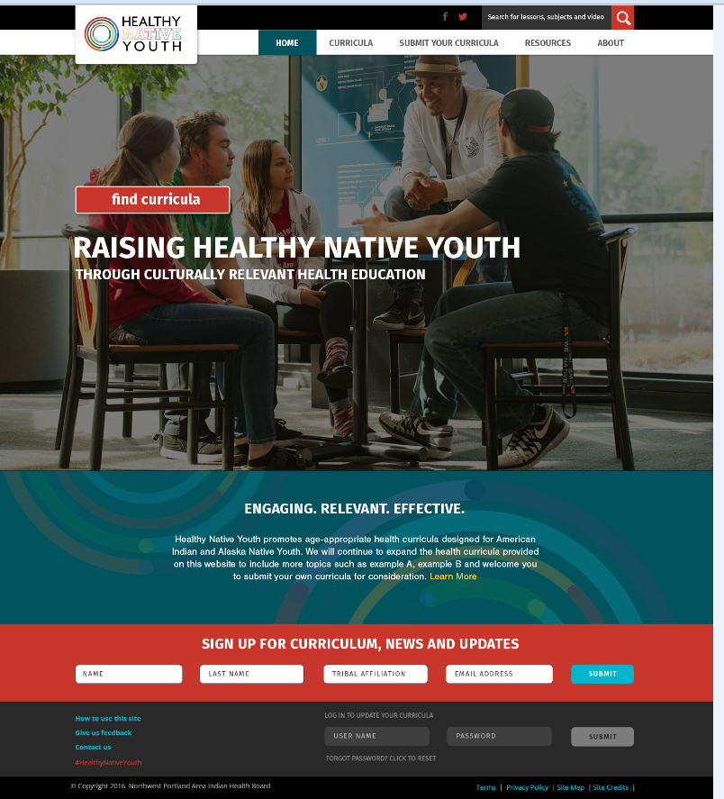
Healthy Native Youth Website
Notes:
To be effective, health curricula must be age-appropriate, culturally-relevant, and reflect the values and learning styles of the learners being taught. Finding curricula that meet these requirements for American Indian and Alaska Native youth can be really challenging.
Designed a website that could help teachers/educators do just that…
www.HealthyNativeYouth.org is a one-stop-shop for tribal health educators, teachers, and parents.

Slide 32
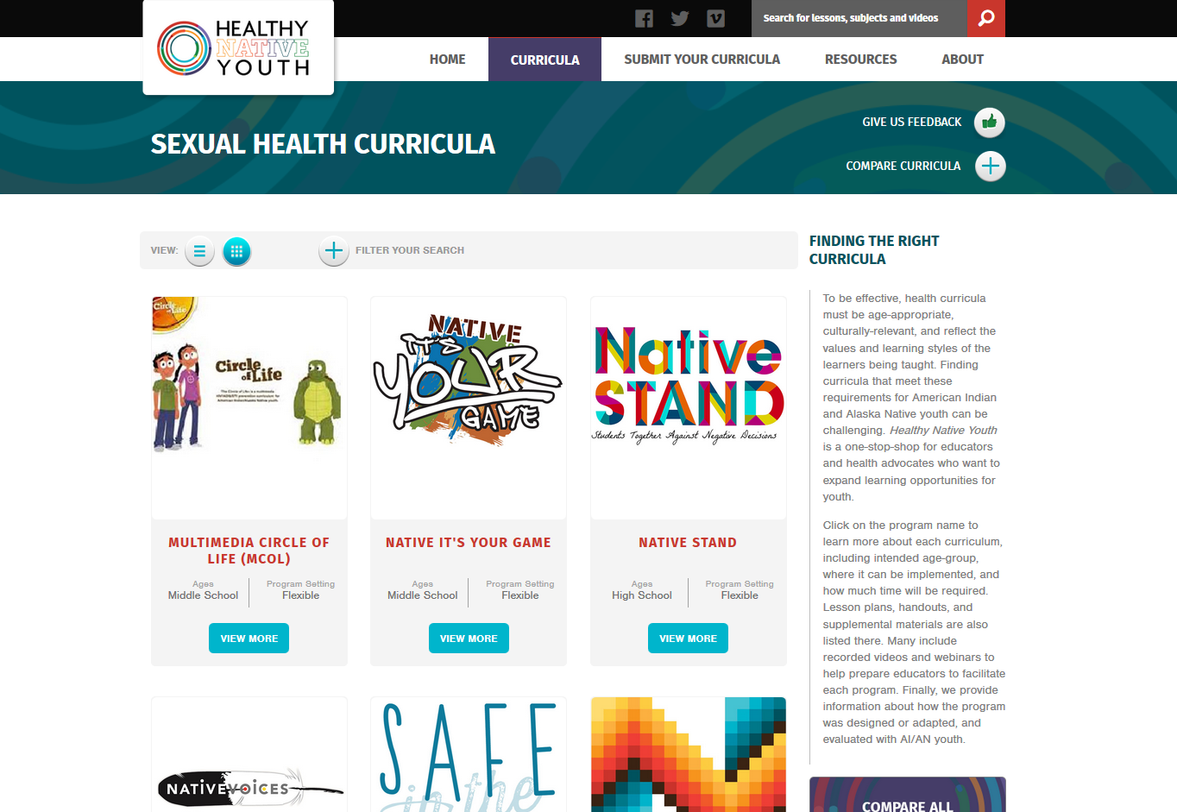
Healthy Native Youth Website
Notes:
From the Curricula tab…
Click on the program name to learn more about each curriculum, including intended age-group, where it can be implemented, and how much time will be required. Lesson plans, handouts, and supplemental materials are also listed there. Many include recorded videos and webinars to help prepare educators to facilitate each program. Finally, we provide information about how the program was designed or adapted, and evaluated with AI/AN youth.

Slide 33
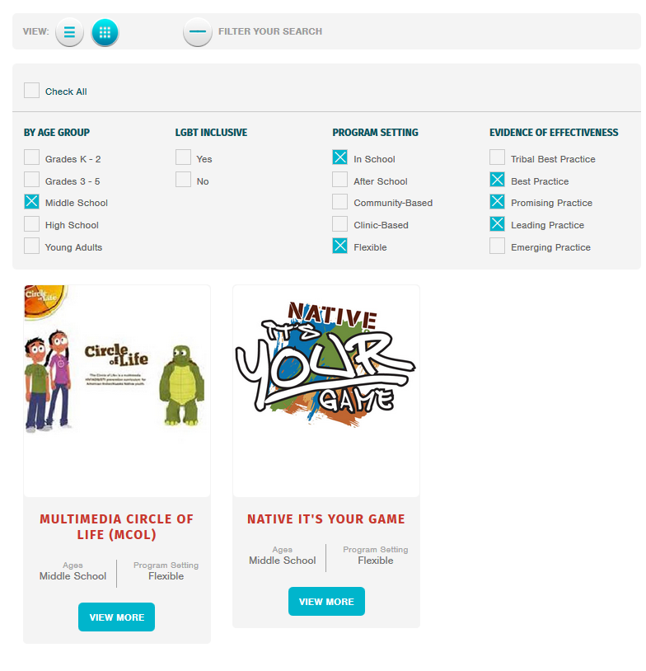
Notes:
You can filter your search by age, lgbt inclusivity, program setting, and evidence of effectiveness

Slide 34
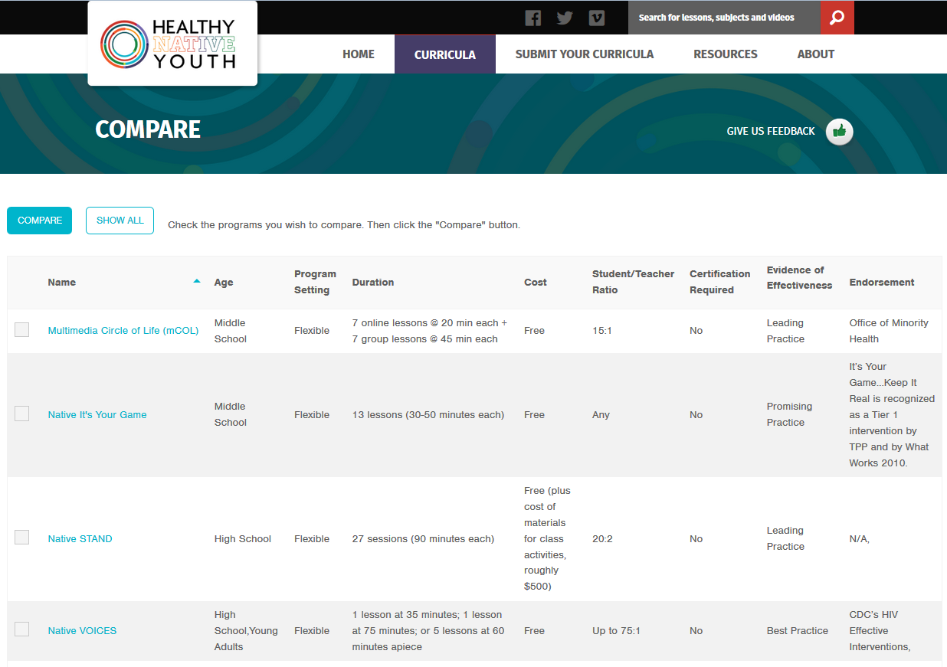
Notes:
You can also compare two or more programs to each other… by class size, cost, or program duration.

Slide 35
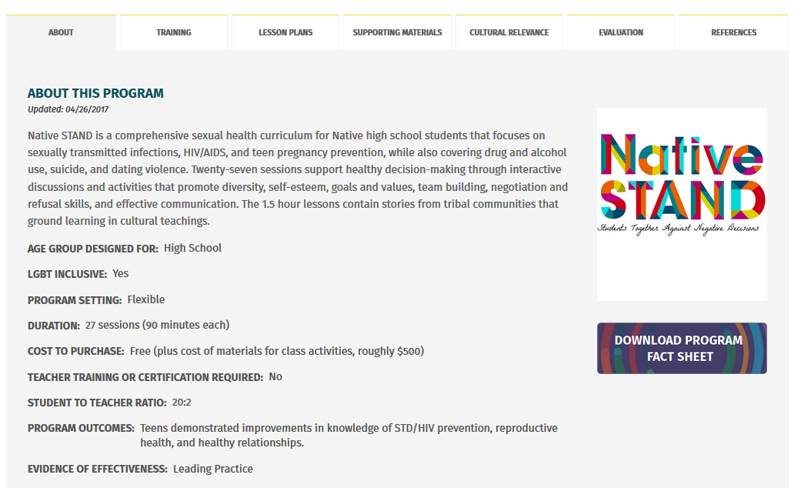

Slide 36
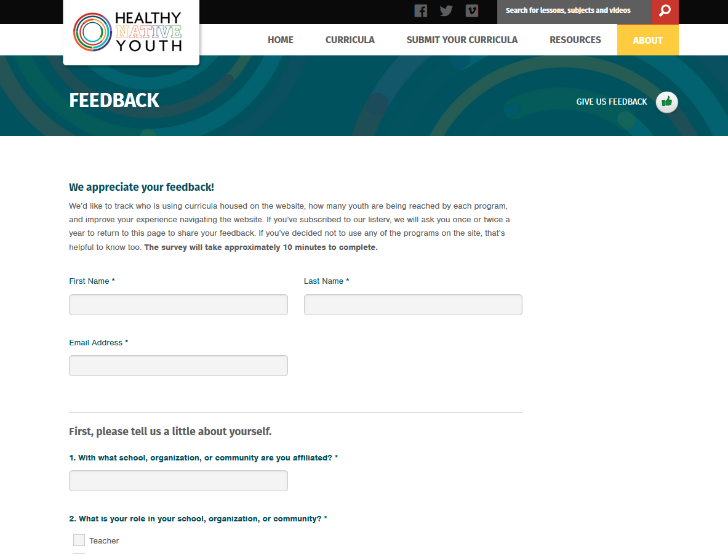

Slide 37
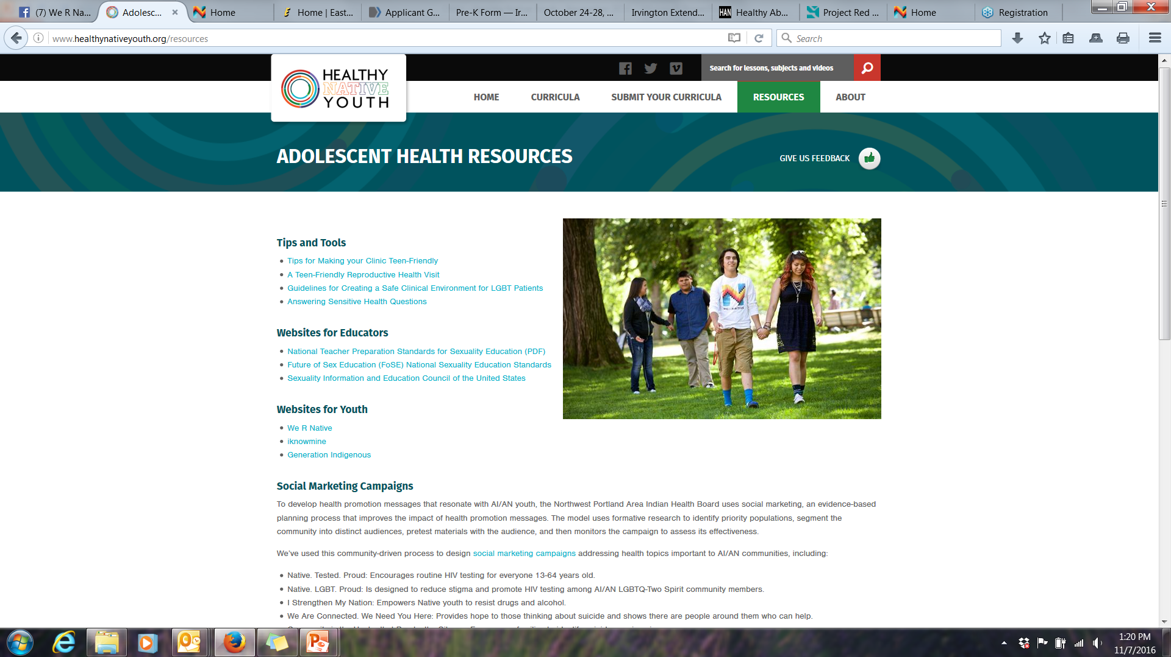

Slide 38

To Get Involved:
Notes:
Share the site with your community networks: www.HealthyNativeYouth.org
Sign up to receive updates about curricula available on the site (in the red bar at the bottom of the homepage)
Follow the site on Facebook (www.facebook.com/HealthyNativeYouth)

Slide 39
Brainstorm: Ideas to Market Healthy Native Youth to Educators?

Slide 40
Northwest Portland Area Indian Health Board
Stephanie Craig Rushing, PhD, MPH
Director – Project Red Talon & THRIVE
scraig@npaihb.org
Colbie Caughlan, MPH
THRIVE Project Manager
ccaughlan@npaihb.org
Celena McCray
THRIVE Coordinator
cmccray@npaihb.org
Amanda Gaston, MAT
Ask Auntie
agaston@npaihb.org
David Stephens, RN
Multimedia Project Specialist
dstephens@npaihb.org
Tommy Ghost Dog
PRT Assistant
tghostdog@npaihb.org
Jessica Leston, MPH
STD/HIV Clinical Services Manager
jleston@npaihb.org
Indian Leadership for Indian Health

Slide 41
This project is funded by the Indian Health Service HIV and behavioral health programs, and is supported in-kind by a SAMHSA GLS grant. This work is also supported in part with funds from the Secretary’s Minority AIDS Initiative Fund.

Slide 42
Self-Care
If any part of this training brings up past or current emotions about a difficult time or experience, please talk with a trusted friend or family member, or a local mental health professional.
Dr. Ursula Whiteside
ursulawhiteside@gmail.com
www.nowmattersnow.org
Notes:
If any part of this study brings up past or current emotions about a difficult time or experience, please talk with a trusted friend or family member, or a local mental health professional. If you are not sure who to connect with, you can contact clinical psychologist Dr. Ursula Whiteside, who has been working with the THRIVE project since 2015, at www.nowmattersnow.org

